Slide 1
Certificate of Leadership
Notes:
These slides are meant to be used by advisors when introducing and explaining the Certificate of Leadership to your students.

Slide 2
Why should I pursue a Certificate of Leadership?
Experience 8 additional opportunities to participate, learn, and critically reflect
Earn a certificate which recognizes student leaders who go “above and beyond” in their learning and leadership development
Interact with student leaders across campus participating in different programs
Notes:
PURPOSE To actively reflect on experiences to enhance the learning of Student Leaders.
To go “above and beyond” what Student Leaders do in their individual programs.
To encourage learning between Student Leaders across campus.
Open to students in Peer Programs, Orientations, and Jump Start

Slide 3
How To earn a Certificate of Leadership:
1. Complete 8 approved learning experiences:
Attend the opportunity (e.g. workshop, event, online module)
Submit reflection online within 2 weeks of attending
Advisor receives and approves reflection
2. Submit final reflection at the end of the year.
NOTE: A Certificate of Leadership can be earned in one year or over multiple years of involvement
Notes:
CRITERIA
Student Leaders must complete 8 learning experiences with reflections to attain the Certificate of Leadership (CoL).
Must complete one experience in each of the 3 learning streams.
Detailed reflection must be completed and submitted on the CoL webpage within two weeks of experience. The Staff Advisor for that student must approve their reflection before it is considered a completed CoL experience.
Reflection must show personal growth, a new experience, or a step outside of one’s comfort zone and link back to the Peer Programs Learning Outcomes, which is reviewed and approved by an Advisor. Note: student could reflect in person with Advisors prior to filling out reflection online, to help generate notes
Opportunity must be posted to the CoL webpage prior to opportunity start date and therefore accessible to all Student Leaders. If opportunity is suggested by the student, it must first be approved by a Staff Advisor.
The experience must be open to all students pursuing a CoL certificate; there can be opportunities with specific criteria (e.g., must be a graduating student, must be an Engineering/Science/Arts student).
A maximum of 3 mandatory learning experiences from your individual program’s training/professional development which are not posted on the CoL webpage can be used as a CoL opportunity provided it meets the Peer Programs Learning Outcomes.
These mandatory learning experiences could be:
any/all sessions offered during September Training, your program’s specific training, and/or SLC. Each workshop/session is a potential CoL learning experience.
any sessions offered by your program that are marked as a CoL experience.
The remaining learning experiences can be taken from the CoL website, UBC and the broader community provided the Leader approaches their Staff Advisor with their experiences before the event and it has been added to the CoL website for all to access.

Slide 4
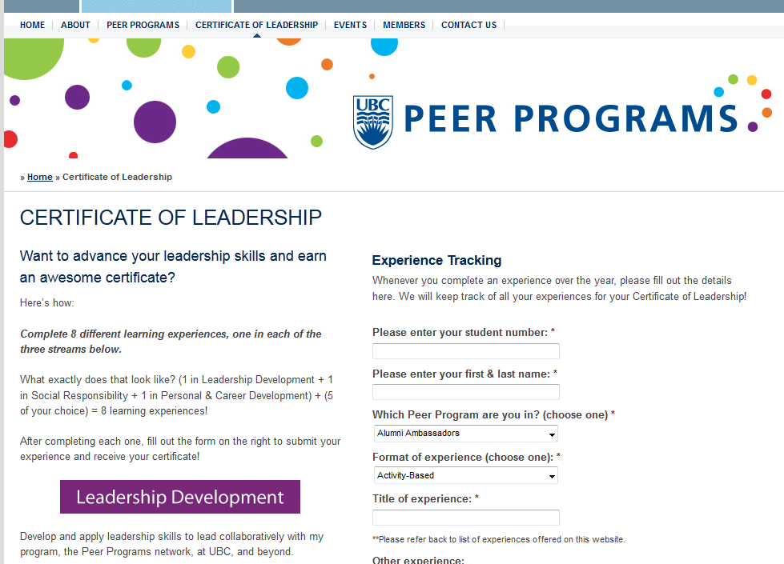
Find opportunities and submit reflection
http://peerprograms.ubc.ca/certificate-of-leadership/
Notes:
All Certificate of Leadership opportunities will be posted to this webpage
All students must submit their reflections to the webpage within 2 weeks of their experience. These online reflections then get automatically sent to their program advisor who will choose to approve the reflection in order for it to be counted towards their COL. Reflections not approved by the program advisor will not be counted towards the COL.

Slide 5
Writing your Reflection
Reflection ideas:
What did you find confusing, inspiring, difficult, interesting and why?
How did the workshop connect to prior knowledge and experiences?
How did new ideas challenge what you already know?
Effective reflection is not:
Purely descriptive
“touchy-feely”
About giving a right answer
Adapted from:
The Learning Centre, University of New South Wales, http://www.lc.unsw.edu.au/onlib/reflect.html
Notes:
This slide is optional – If your student want to know more about reflecting or have further questions, please refer to this slide.

